Slide 1




Astronomy 1010 chapter 18
Clayton State University
Slides for Astronomy textbook from OpenStax
https://openstax.org/books/astronomy/

Slide 2
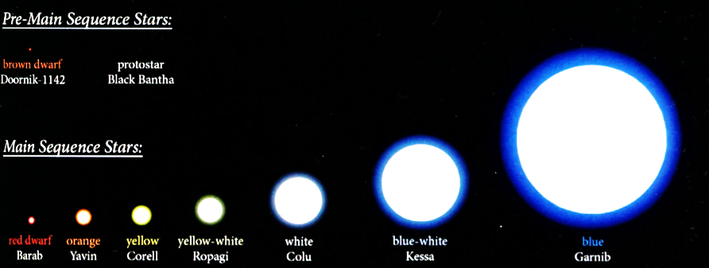
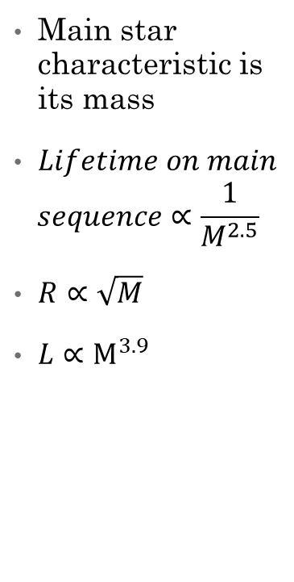
Star Census
Stars within 21 Light-Years of the Sun
Spectral Type | Number of Stars
A | 2
F | 1
G | 7
K | 17
M | 94
White dwarfs | 8
Brown dwarfs | 33
Main star characteristic is its mass
$Lifetime on main$
$$sequence∝\frac{1}{M^{2.5}}$$
$R∝\sqrt{M}$
$L∝M^{3.9}$

Slide 3
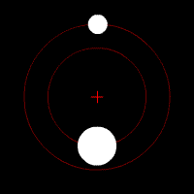
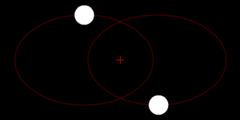
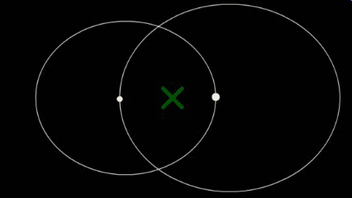
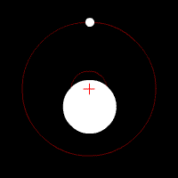
Binary stars
Try to say which stars are same by mass, and which are very different…
How close to each other are they?

Slide 4
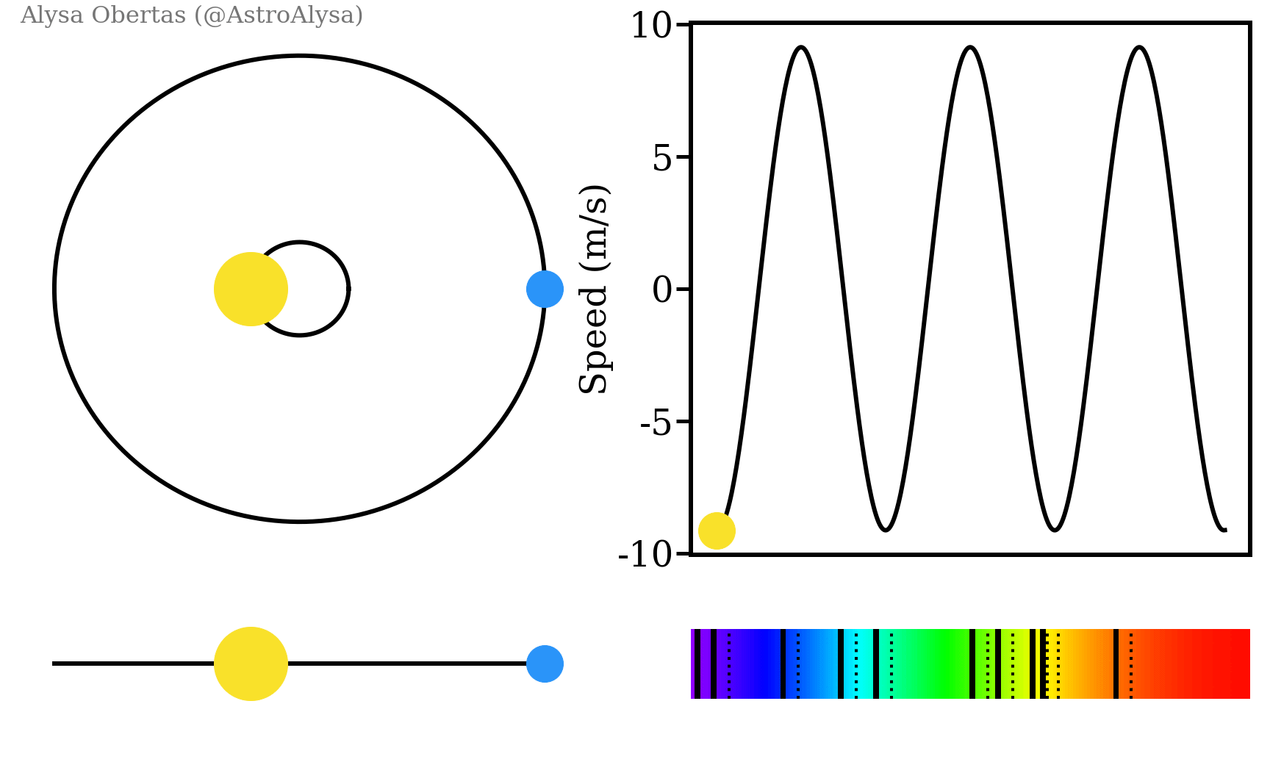
Spectroscopic Binaries
Other types of binaries are here: https://en.wikipedia.org/wiki/Binary_star
Can use spectral lines to measure velocity

Slide 5
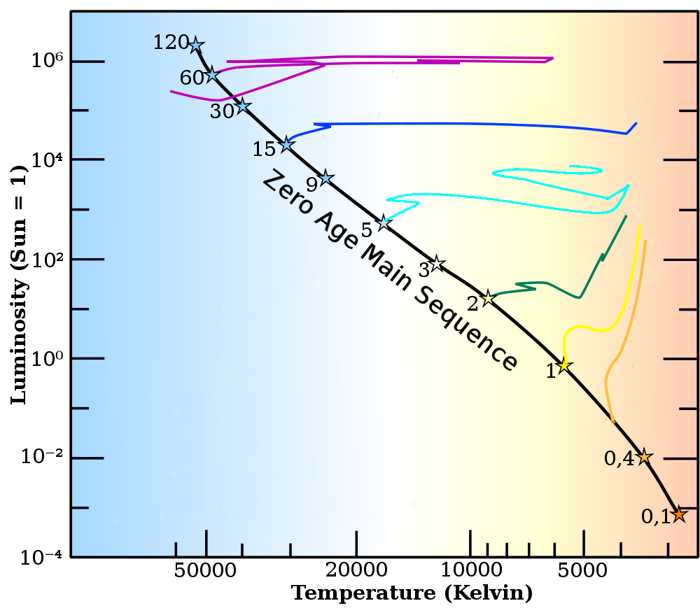
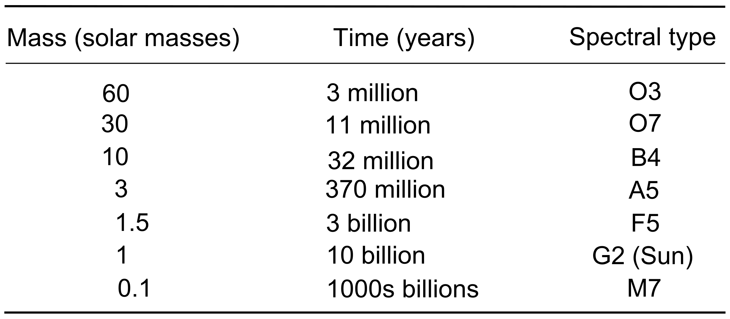
Mass ranges for stars
The smallest object mass that can have nuclear fission in the core is ~0.1M☉
The most massive know star that is still stable has 226 M☉
  BAT99-98 is a star in the Large Magellanic Cloud. It is located near the R136 cluster in the 30 Doradus nebula. At 226 M☉ and 5,000,000 L☉ it is one of the most massive and luminous stars known.

Slide 6
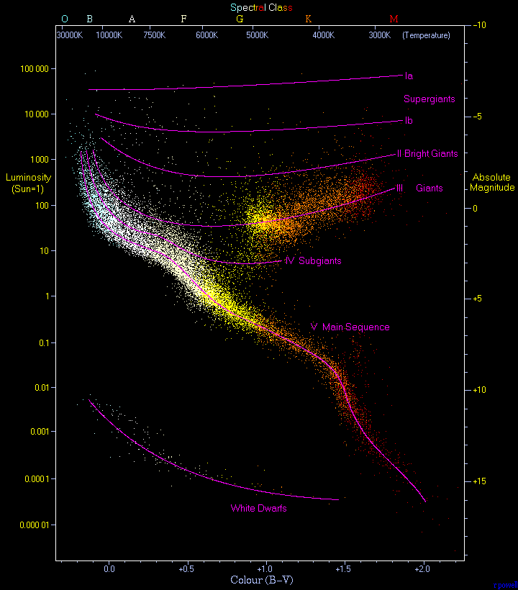
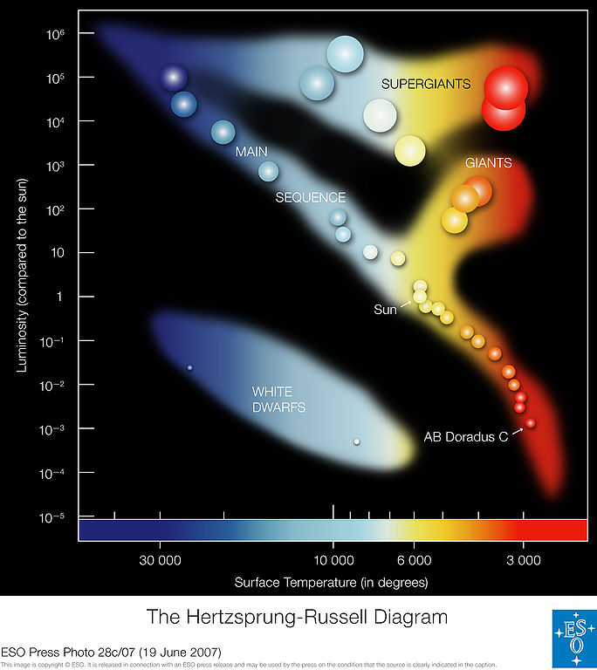
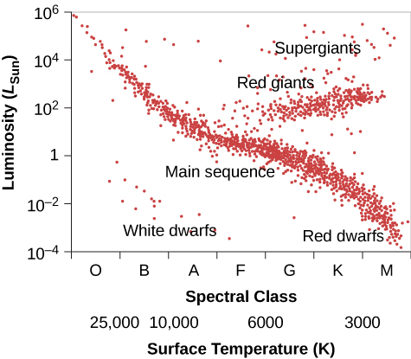
H-R Diagram
Hertzsprung-Russell (H-R) diagram is a graph in which the absolute magnitudes (or intrinsic brightness) of stars are plotted against their spectral types (or temperatures).
Can show star evolution from birth to death
This Photo by Unknown Author is licensed under CC BY-SA

Slide 7
Interactive H-R diagram
http://astronomy.nmsu.edu/geas/labs/hrde/hrd_explorer.html
Explore the position of the Sun in the diagram and how changes in temperature and luminosity move the star along the diagram
How can we find the star mass or radius on the diagram?
What are the features of the star groups away from the main sequence?
How many stars are on the main sequence? What is their lifetime there?

Slide 8
Any Questions?

